Slide 1

Bolt 1.0
Bolt Elegna
Bolt 3.0
Bolt Lite 2.0
Bolt Lite Pro
FlexiBolt 2.0
Bolt 3.0
Bolt Lite Fast
“Redefining your computing experience”
Bolt Ultra Max
Bolt Elegna Max

Slide 2

ACE Inc.
A - Agile
C - Computing
E - Excellence
“Redefining your computing experience”
B2B Marketing| Simulation
Group-7 | TIME | DDS
Aachen | 30 June 2020

Slide 3





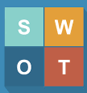

AGENDA
01
Mission and Vision
02
Meet our Team
03
Strategy of ACE Inc.
04
Marketing Mix 4P’s
ACE Inc.
“Redefining your computing experience”
05
Financial Performance
06
Analysis
07
Lessons learned

Slide 4



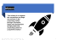
MISSION
VISION
OUR TEAM

Slide 5
Mission
“Our mission is to outgrow the competition and forge our presence in the computing market through innovation, design and development of high performing computing systems in competitive market.”

Slide 6

Vision
“We aim to ACE the computing world and emerge as an industrial leader for computing excellence.”
© Akshay.P, Amey.W, Amruta.T, Bhakti.K, Gaurav.K, Omkar.P, Shreyas.P, Vyas

Slide 7
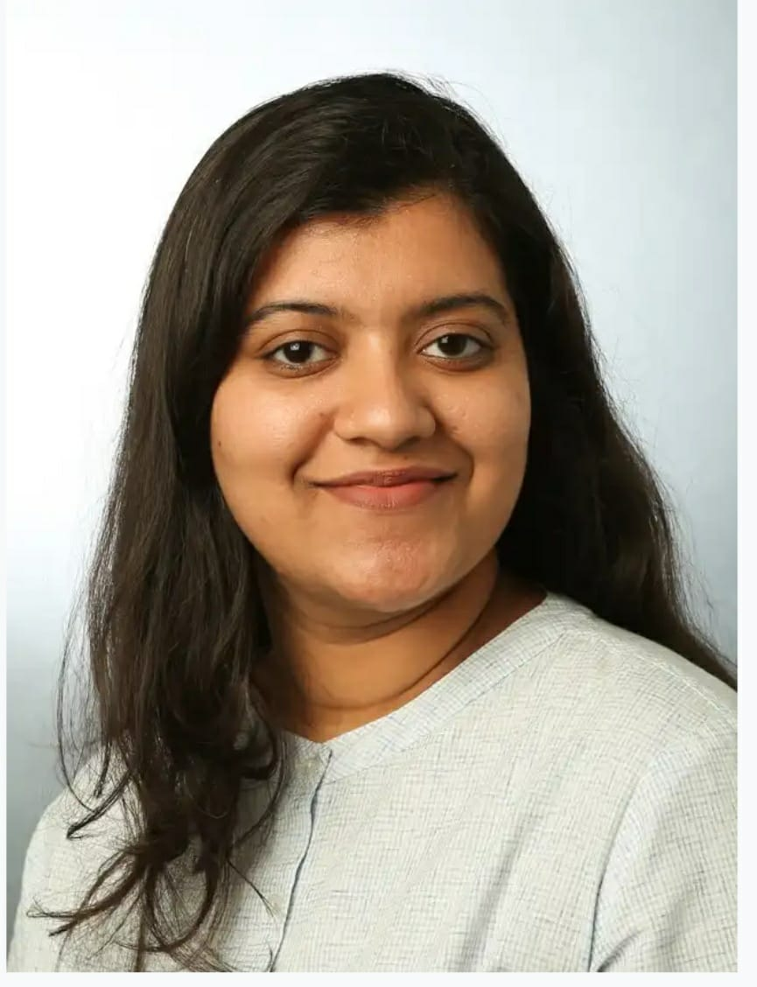

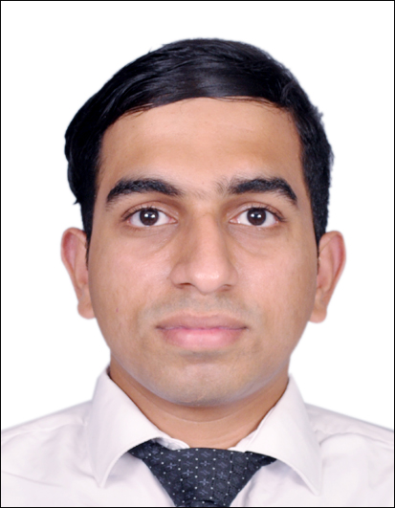

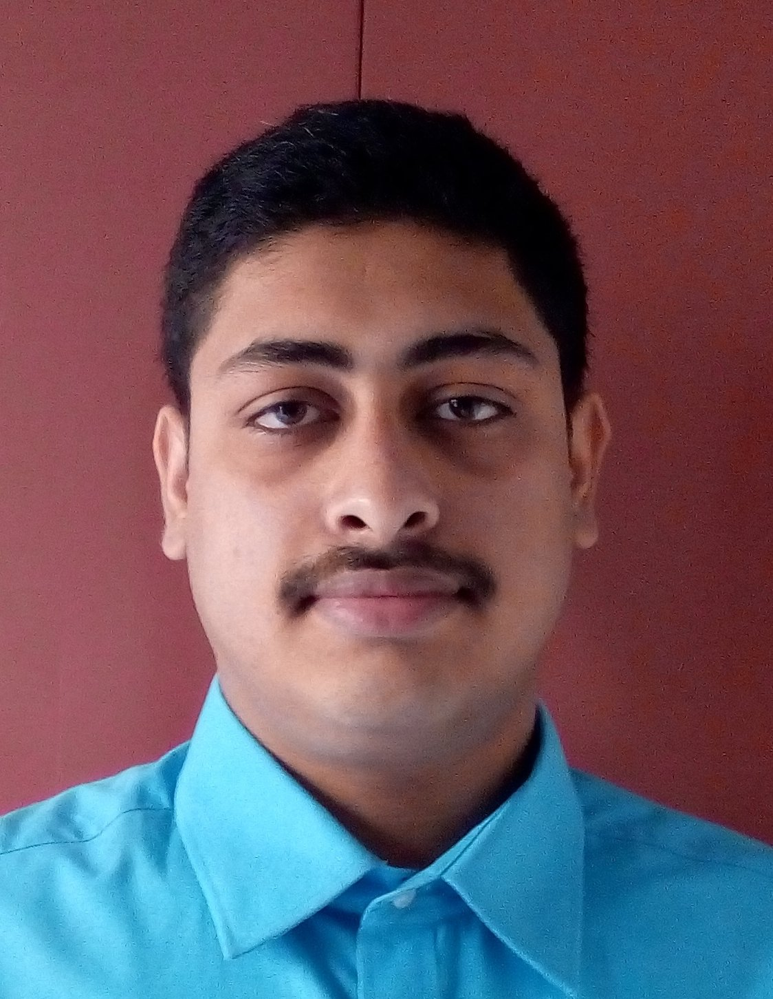

Meet Our Team
Bhakti Khopade
PRESIDENT OVERALL LEADERSHIP
Mat. No. 404218
Amruta Taksale
VP BRAND
MANAGEMENT
Mat. No. 403155
Akshay Patne
VP BRAND MANAGEMENT
Mat. No - 402922
Amey Wadekar
VP BRAND MANAGEMENT
Mat. No. - 402903
Sai Vyas
VP FINANCE
Mat. No. – 402704
Gaurav K.
VP BUSINESS ANALYTICS
Mat. No. – 402742
Omkar P.
VP BUSINESS ANALYTICS
Mat. No. - 403952
Shreyas P.
VP SALES MANAGEMENT
Mat. No. – 406174

Slide 8



Analysis of Market Segments
Our Customer Segments were :
1) Mercedes
2) Workhorse
3) Travelers
First and foremost step to start with was to identify the needs of our segments and map them into our products.

Slide 9
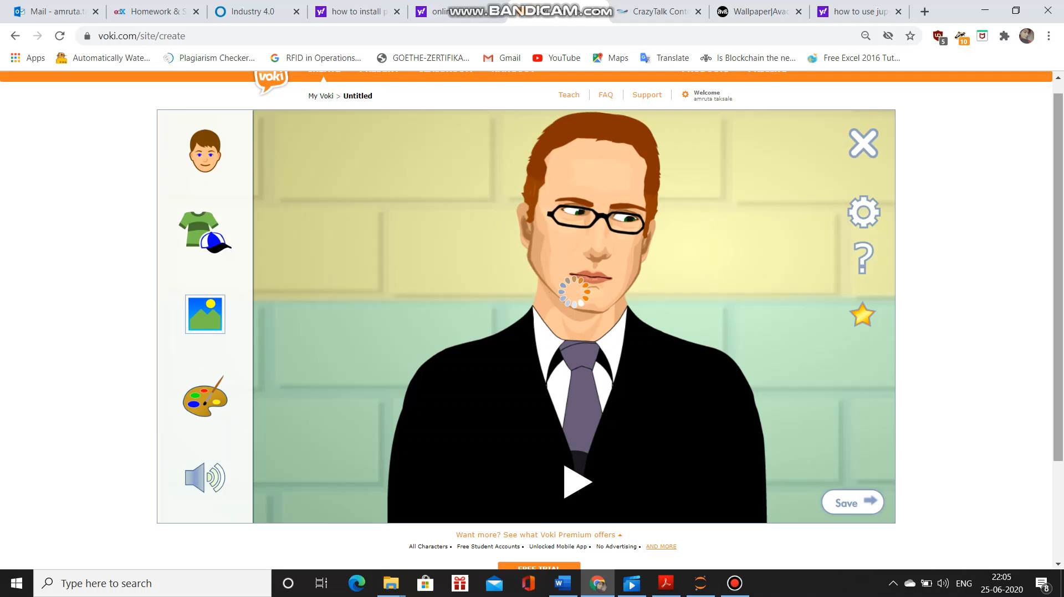
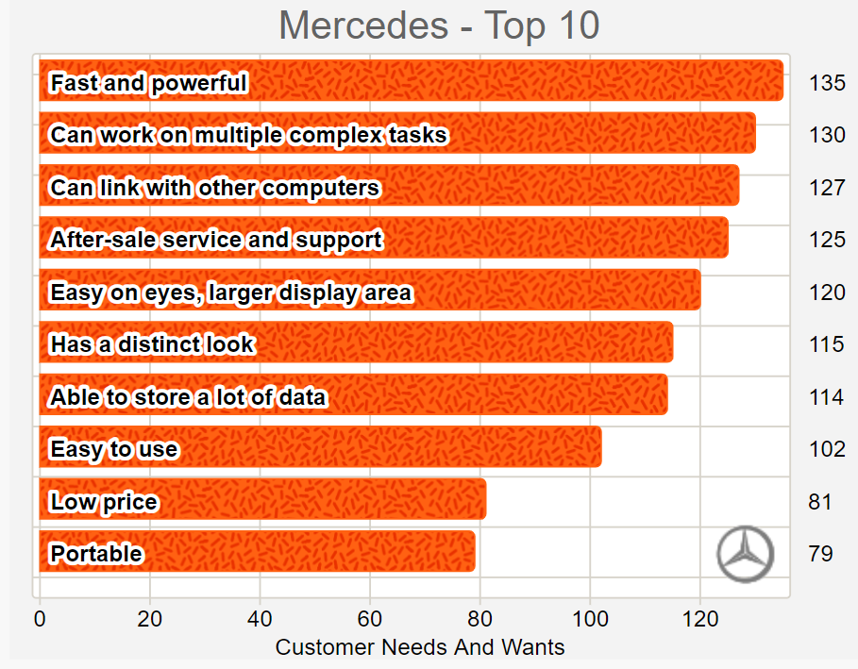
Ben,
(Works at DesignTech with complex apps.)
Our Offerings
On reviewing the needs of Mercedes Customers we launched-Bolt Ultra Max, Bolt 3.0 and Bolt 2.0 by accurately mapping their requirements.
Bolt Ultra Max ,Bolt 2.0 and Bolt 3.0 being Our top Mercedes brands brought 34% of the total revenue each.

Slide 10
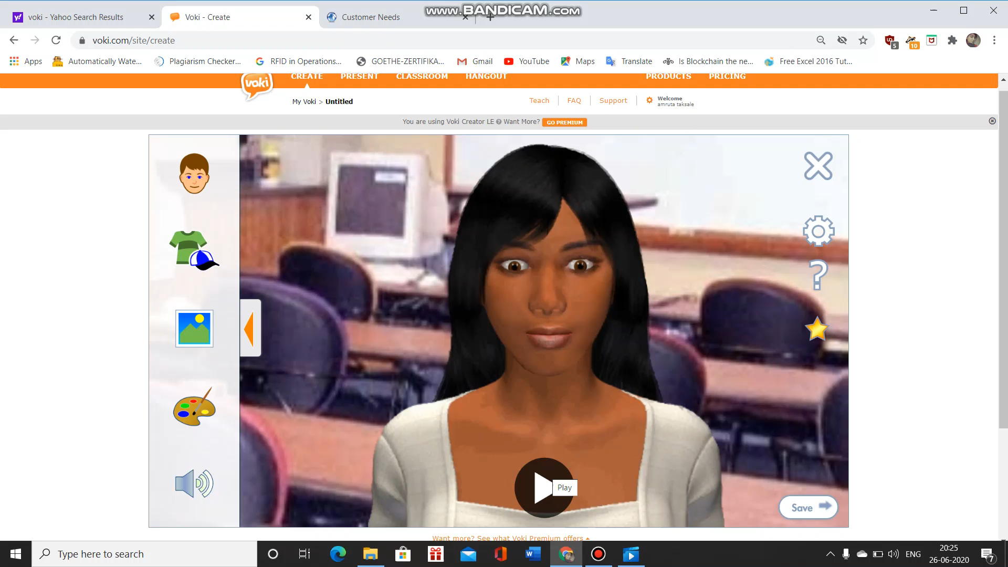
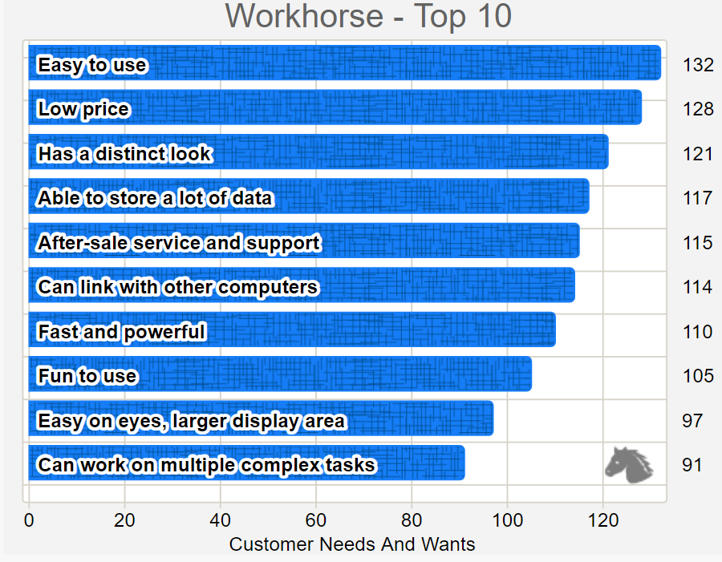
Eva
(Works with databases and power-points)
Our Offerings
Our products Bolt Lite Pro, Bolt Lite Fast, Bolt Lite 2.0 mapped all the requirements of the customers.
Bolt Lite Pro brought 20% of the total revenues followed by Bolt Lite 2.0 with 15% and Bolt Lite Fast with 13%.

Slide 11
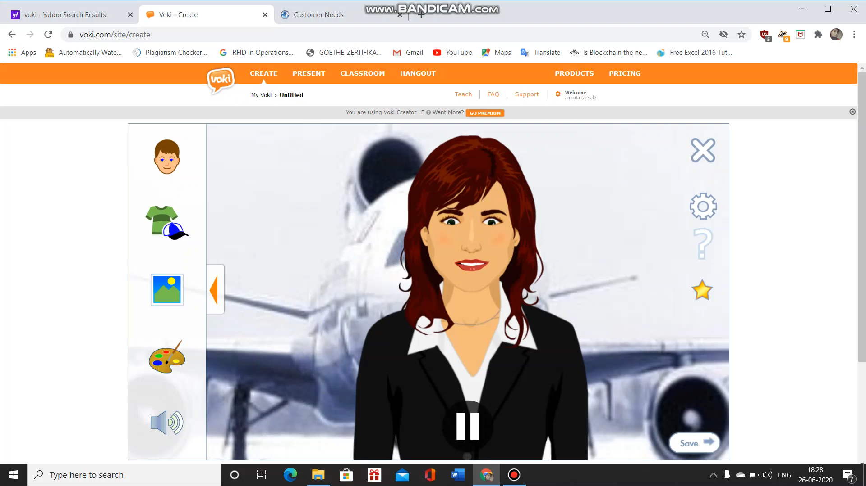
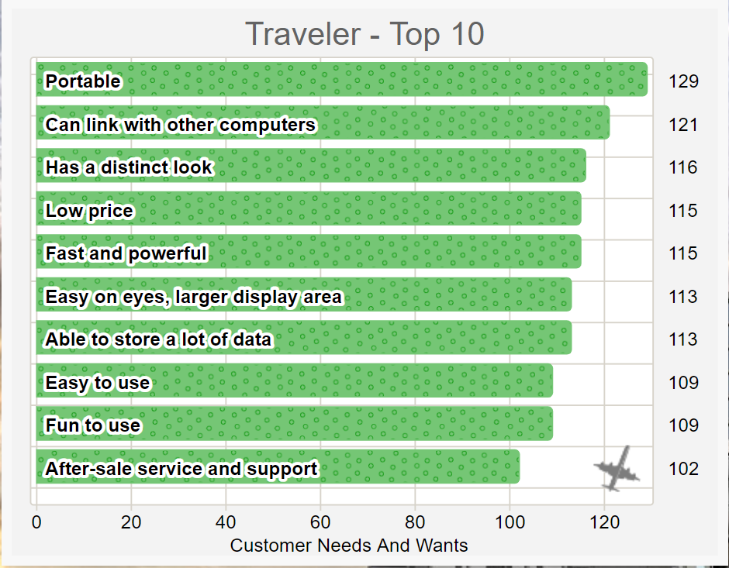
Lea
(Frequently travels for work tours)
Our Offerings
We considered the needs of the Traveller segment and came up with Bolt Elegna and Bolt Elegna Max.
Bolt Elegna was the most successful brands from all Our brands yielding 38% of Our total revenues. Bolt Elegna Max gave 34% of the total revenues.

Slide 12





Why Mercedes-First Priority?
The overall market potential for Mercedes was 36%, so we considered it to be a major revenue generator amongst the three segments.
We wanted to cater High profit target segment
We wanted to extract the “High willingness to pay” of the target segment by providing them premium products.
Target Segment | Willingness to Pay | Segment Priority
Mercedes | 4000 | First
Workhorse | 2500 | Second
Traveler | 3200 | Third
2500
3200
4000

Slide 13
Workhorse and Traveller Target Segments
After establishing our brand in the Mercedes Segment we decided to tap into Workhouse and Travelers segment.
We decided to cater for the other 2 segments in order to exploit remaining huge market demand.
We wanted to increase the market share by penetrating into all the three segments.

Slide 14
Market Segmentation Target Segment Analysis
Paris (Q4)
Mercedes:4,722
Traveler:3,685
Workhorse:7,043
Rent - Highest
Chicago (Q1)
Mercedes:6004
Traveler:4321
Workhorse:7031
Rent - Low
Shanghai (Q3)
Mercedes : 3,335
Traveler : 2,553
Workhorse : 7470
Rent - Medium
Sau Paulo (Q2)
Mercedes : 2,596
Traveler : 2,132
Workhorse :6,127
Rent - Lowest
Target Segment | Segment Priority
Mercedes | First
Workhorse | Second
Traveler | Third

Slide 15
Analysing Strategies
Analyse market
Brand/ad/price judgement
Analyse Competition
Marketing strategy adopted by competitors
Competitor brands and placements analyze market
Tracing offerings and rebates analyze competition

Slide 16

Strategies of Ace Inc.
Branding Strategy

Slide 17



Strategy of Ace Inc.| Brand Strategy
Market Penetration Strategy
Aim - To create a foothold of company name and the product developed within the current market to gain customer loyalty.
Attracting the target segment- Slightly revising the strategy for consumers to consume the existing products/services.
Low risk strategy
Current Products
New Products
Current Markets
Market
Penetration
Product Development
Diversification strategy
Tapping into new target segments by developing brands mapped with the customer needs.
Offering completely new products with various variants due to market saturation and customer dependency on existing products.
High risk strategy
New Markets
Market
Development
Diversification
Product Development Strategy
Offering new products to the existing market to exploit the new technology.
Extend the market share by introducing incremental innovative products and utilising the excessive production capacity
Moderate risk strategy
Ansoff Matrix
Source: Harvard Business Review, Ansoff (1957)

Slide 18
Brand Strategy of Ace Inc. | Product Management
Current Products
New Products
Current Markets
Market Penetration
Mercedes: Bolt
Product Development
Mercedes: Bolt Ultra, Bolt Ultra Max
Workhorse: Bolt Lite Pro, Bolt Lite Fast
Traveler- Bolt Elegna, Bolt Elegna Max
Market Development
Diversification
Workhorse: Bolt Lite
Traveler- Flexibolt
New Markets

Slide 19

Strategies of Ace Inc.
Branding Strategy
Advertising Strategy

Slide 20
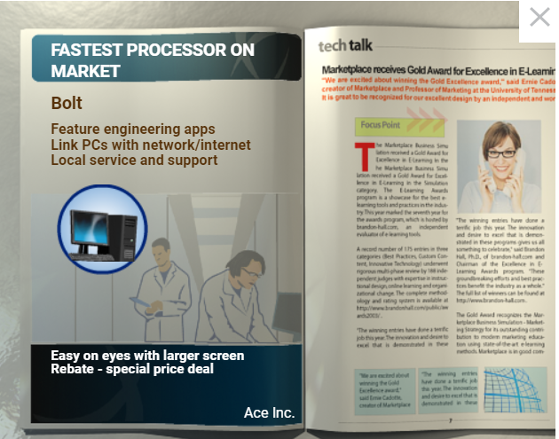
Strategy of Ace Inc.| Advertising Strategy
Awareness
Initially we showcased all our product features in our advertisement to create an impression on our product for the customer.
It portrays a complete picture of our product which is an essential step for initial brand advertisement
We applied this strategy in Q3
Interest
Later in the all quarters we applied interest strategy to showcase only highlighted features of product to create an interest amongst our customers.
We created attractive advertisement by prioritising the highest rated need / basic need of the customer
This helped to capture the attention of customer

Slide 21

Strategies of Ace Inc.
Branding Strategy
Advertising Strategy
Pricing Strategy

Slide 22
Strategy of Ace Inc.| Pricing Strategy
Value Based Pricing
Q1, Q2
Products in these quarters were designed as per customer needs and values (top 5 needs and applications of Mercedes).
Cost based pricing
Q3, Q4
Workhorse and Traveler products pricing were based on all costs incurred during production.
Competition based pricing
Q5, Q6
We came up with Dynamic pricing strategy to maximize the profits from each segment and to match the market condition.
Focused on increasing customer loyalty.
In Q4 we came up with psychological pricing strategy to capture the Workhorse segment.
For the Mercedes segment we increased the price of the product to improve the profits.
To spike demand in new products and to help increase the sales

Slide 23


Strategy of Ace Inc.| Price Adjustment Strategies
Mercedes target segment
Price sensitivity- The Mercedes target segment is less price sensitive
Dynamic Pricing -Dynamic Pricing : Products pricing was adjusted constantly to meet the requirements and needs of the customers and the competitive situation
Workhorse target segment
Price sensitivity- Price sensitivity was very high.
Traveler target segment
Discount and Allowance Pricing - Our strategy to attract these segment was to provide discounted price and increase the sales.
Price sensitivity-The price sensitivity was moderate for traveler target segment.
Competition based pricing – Price derived from competitors and current market conditions
We also aimed to sell low-priced products in high volumes using this strategy
Bolt ultra max
Bolt
Bolt 1.0
Bolt 2.0
Bolt 3.0
Bolt lite
Bolt Lite Pro
Bolt lite Fast
Bolt Lite 2.0
Bolt Elegna Max
Bolt Elegna
Flexibolt 2.0
Flexibolt

Slide 24

Strategies of Ace Inc.
Branding Strategy
Advertising Strategy
Pricing Strategy
Basic Sales Force and Management Strategy

Slide 25

Strategy of Ace Inc.| Sales force management
Factors | Startup Phase Q1, Q2 | Growth Phase Q3, Q4 | Maturity Phase Q5, Q6
Role of sales force
Size of sales force
Degree of sales specialization
Degree of sales training
Underlying Customer Strategy | Knowing the customers at granular level and creating awareness. | Targeting new customer segment by introducing the desired products. Focusing on maintaining the customer loyalty of the primary target segment. | Effectively retaining existing customers and to maintain the customer relationship.
Source: Harvard Business Review

Slide 26
Strategy of Ace Inc.| Sales force management
Annual Salary: 100,000
Annual Salary: 120,000
Annual Salary: 60,000
Annual Salary: 70,000

Slide 27
Strategies of Ace Inc.
Branding Strategy
Advertising Strategy
Pricing Strategy
Basic Sales Force and Management Strategy
Financial Strategy

Slide 28
Strategy of Ace Inc.| Financial Strategy
Conservative approach
Initial quarters took this approach to create working capital for further expansion in later quarters. For working capital financing, ACE Inc had to maintain high level of liquidity in relation to unit sales to create enough room for unforeseen expenses in the future. Basically, we want to be best prepared for a worst-case scenario, so that intensity of worseness reduces. So, less outflow, more inflow first.
Aggressive approach
Although risky in meeting short-term obligations such as operation expenses for next quarter, during our Q4,Q5 our aggressive approach helped us to stay strong with a cumulative profit of $27.5mn. Spending wherever needed, as much as we can in operation expenses coupled with market research, once comfortable with liquidity.

Slide 29
Marketing Strategy 4P’s
Q1

Slide 30
PRODUCT
PRICE
PLACE
PROMOTION
PRODUCT
PRICE
PLACE
PROMOTION
Q1
Q2

Slide 31
Marketing Strategy 4P’s | Quarter 2 decisions
PRODUCT
PLACE
Target
Segment
To extract customers high willingness to pay, we focused on Mercedes as our primary target segment.
Brand
Name
We came with our Brand “Bolt” which signified high speed , networking ,and linking feature as per our customer requirement
We planned to open new sales office in “Sau Paolo” as the Quarter lease cost was least(8000) in Sau Paolo among all the 4 regions.

Slide 32
PRODUCT
PRICE
PLACE
PROMOTION
PRODUCT
PRICE
PLACE
PROMOTION
Q1
Q2
Q3
PRODUCT
PRICE
PLACE
PROMOTION

Slide 33
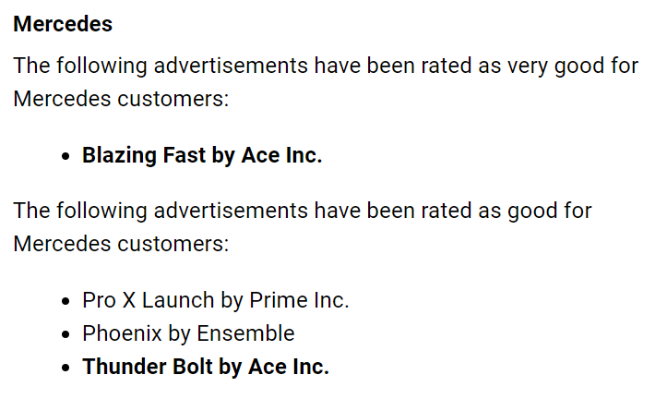
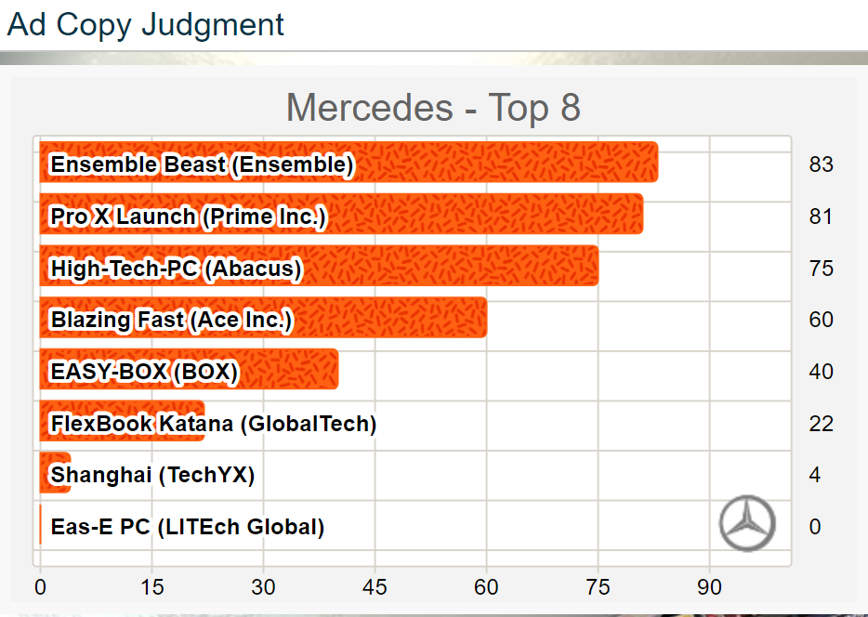
Marketing Strategy 4P’s | Quarter 3 decisions
Promotion
Advertising
Both the Advertisements-Thunderbolt and Blazing fast were designed carefully considering the customer preferences.
Media Placements
Blazing Fast was exclusively designed for Chicago-NORAM. Whereas Thunder-Bolt was deigned for Sao Paolo. So we gave the placements for Chicago and Sao Paolo respectively.
Sales force management
Pertaining to the less sales in the previous quarter due to inadequate deployment of sales force, the management decision was to ramp up the sales force in Chicago and Sau Paulo. Increasing the sales force in Chicago, in-turn increased our sales in Chicago as well as Sao Paulo.

Slide 34
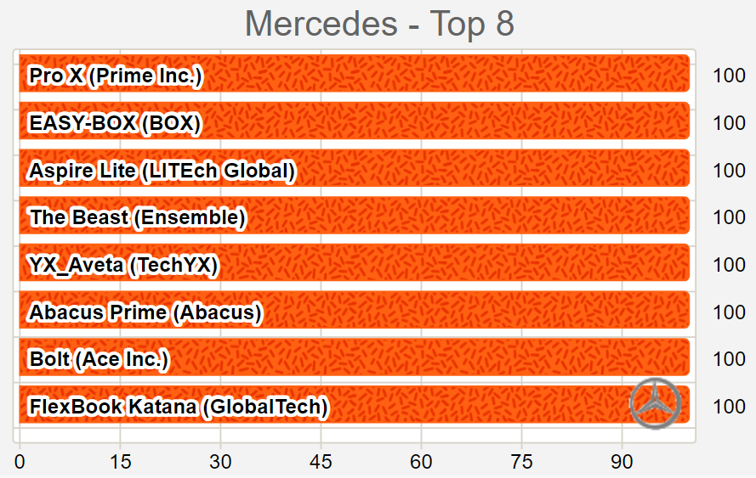
Marketing Strategy 4P’s | Quarter 3 decisions
Pricing
Quarter 3 Price Judgement
As our target customers were less price sensitive and having the highest willingness to pay the pricing set were at a higher side but were in lined with the competitors prices.

Slide 35
PRODUCT
PRICE
PLACE
PROMOTION
PRODUCT
PRICE
PLACE
PROMOTION
Q1
Q2
PRODUCT
PRICE
PLACE
PROMOTION
Q3
Q4
PRODUCT
PRICE
PLACE
PROMOTION

Slide 36
Marketing Strategy 4P’s | Quarter 4 decisions
Product
Place
Late to the market
High Rent
Till previous quarter we tried to capture the regions with low rents to maintain balance between profits earned and our expenses
The decision of entering Paris as the last location was to deal with the fact that it was a saturated market with already established brands.
Mercedes target segment
As our brand was one of the leaders in Chicago, Sau Paulo and Shanghai, continued with the same brand.
Workhorse target segment
Tapping into new market to diversify our target segment.
Traveler target segment
Brands-
Bolt
Targeting Brands- 1. Bolt Lite
Brands-FlexiBolt
Workhorse was our secondary target segment as Market potential was higher than traveller segment.
Targeting Traveler as a Tertiary target segment.
We kept traveller segment to be our last priority as market share was the lowest.

Slide 37
PRODUCT
PRICE
PLACE
PROMOTION
PRODUCT
PRICE
PLACE
PROMOTION
Q1
Q2
PRODUCT
PRICE
PLACE
PROMOTION
Q3
PRODUCT
PRICE
PLACE
PROMOTION
Q5
Q4
PRODUCT
PRICE
PLACE
PROMOTION

Slide 38
Marketing Strategy 4P’s | Quarter 5 decisions
Product
Promotion
Mercedes target segment
Introduced 2 new brands for the existing brand portfolio
Workhorse target segment
Traveler target segment
Extending the existing brand structure by adding 2 new products that included the newest features.
Brands-
Bolt Ultra Max(Highest variant)
Bolt Ultra(Laptop-Medium variant)
Being the secondary target segment, it was necessary to have a diversified brand portfolio for this target segment
Brands-
Bolt Lite fast (Highest Variant)
Bolt Lite Pro(Medium variant)
Brands-
Bolt Elegna Max (Highest variant)
Bolt Elegna (Medium variant)
Advertisement Design
Mapping the customer needs with the product and adjusting the advertising strategy for the new products entering the new market.
Media Placements
For new products, depending upon the potential demand of every region for respective target segments we assigned the frequency of media placements.
Aggressive advertisement strategy- Need to penetrate the new market with new products.
Sales force management
Specialized training for sales people with respect to the target segments would in turn increase the market demand and contribute significantly to sales.

Slide 39
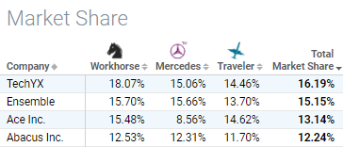
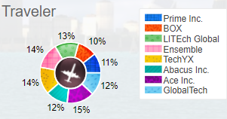
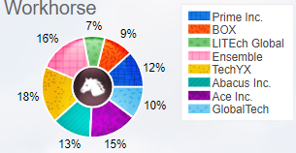
Marketing Strategy 4P’s | Quarter 5 decisions
Implications
What went correct?
What went wrong?
Product Differentiation strategy- Introducing Portable laptop (Bolt Ultra) for the Mercedes target segment as a means of product differentiation failed and received low demand and product judgement.
Modification for Product and Advertisements for existing products- Failure to upgrade the product and the advertisements according to technology change led us to have a low market demand for the existing products (Bolt, Flexibolt and Bolt Lite)
Claimed 3rd highest market share in the overall computing market.
Highest market share in the Traveler segment and 3rd highest market share for Workhorse segment

Slide 40
PRODUCT
PRICE
PLACE
PROMOTION
PRODUCT
PRICE
PLACE
PROMOTION
Q1
Q2
PRODUCT
PRICE
PLACE
PROMOTION
PRODUCT
PRICE
PLACE
PROMOTION
Q3
Q5
PRODUCT
PRICE
PLACE
PROMOTION
Q4
PRODUCT
PRICE
PLACE
PROMOTION
Q6

Slide 41
Marketing Strategy 4P’s | Quarter 6 decisions
Price
Promotion
Mercedes target segment
Premium Pricing: Mercedes segment had high willingness to pay and also wanted high performing machines.
Workhorse target segment
Traveler target segment
We incurred high profit margins on these products.
Discount and Allowance Pricing: Workhorse segment had the highest market size so, we focused on volume generation and accelerating the sales.
Competitive Pricing: For the Traveler segment we stuck to the same pricing strategy which was used in quarter 5.
We maintained competitive pricing as our sales in this segment was highest in the market
Advertisement
We focused on improving the ad judgement with respect to our target segment which is Mercedes.
Media Placement
Media placements were increased in Mercedes segment as they were the most profitable segments.
Advertise of newly upgraded old brand in all the segments.

Slide 42
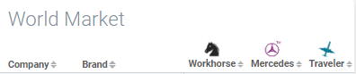
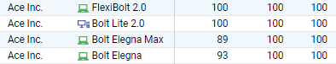
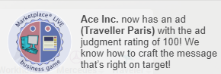
Marketing Strategy 4P’s | Quarter 6 Implications
What went correct?
Bolt Elegna Max had the Highest ad judgement rating(100) in Paris
What went wrong?
Approximately 6 products had the highest price judgement in all the target segments.
Financial Performance
We failed to channelize relationship
with customers, because we
introduced constantly new products,
giving no stability to our customers.
Total Sales Decreased number of units sold resulted in downfall of revenue. Lack of stability in brands, focus shifted from other target segments to primary target segments.

Slide 43

Financial Performance
Highlights

Slide 44




Financial Performance
Highlights
Substantial growth in revenue, expenses & profits. Maximum revenue growth started in Q3 survived until Q4. Even a negative growth of revenue in Q6 brought in a substantial amount of revenue highlighting the need for concentration on unexplored market.
Robust financial health with very strong balance sheet each quarter with zero debt and a cumulative net profit of $27.5 million by Q6 indicating need for further penetration in the market
Highest unit sales across segments brought in the most revenue. Top 3 successful products, Bolt Ultra Max, Bolt Elegna Max, Bolt Lite Fast brought in most revenues with decent price margins
Direct relationship between growth in cash outflow with cash inflow Slow growth in operational expenses such as salesforce, advertisements explain less revenue for Q5, Q6.

Slide 45

Financial Performance
Highlights
Financial Health

Slide 46
Financial Performance Financial Health
Division Profitability
Profit | Quarter 1 | Quarter 2 | Quarter 3 | Quarter 4 | Quarter 5 | Quarter 6
Gross Profit
Revenues | 0 | 708,000 | 3,063,234 | 22,443,004 | 56,588,260 | 38,997,750
- Rebates | 0 | 4,400 | 42,513 | 919,900 | 1,961,000 | 1,321,800
- Cost of Goods Sold | 0 | 375,581 | 1,539,164 | 10,296,959 | 34,322,007 | 22,995,176
= Gross Profit | 0 | 328,019 | 1,481,557 | 11,226,145 | 20,305,253 | 14,680,774
Expenses
Sales Office Leases | 0 | 130,000 | 210,000 | 310,000 | 460,000 | 460,000
+ Sales Force Expense | 0 | 57,000 | 333,000 | 1,126,500 | 2,400,500 | 6,278,500
+ Ad Creation/Revision | 0 | 30,000 | 60,000 | 90,000 | 180,000 | 270,000
+ Advertising Expenses | 0 | 29,567 | 127,092 | 635,340 | 2,344,369 | 4,152,791
+ Engineering Cost for New Brands | 0 | 60,000 | 0 | 120,000 | 360,000 | 300,000
= Operating Expenses | 0 | 306,567 | 730,092 | 2,281,840 | 5,744,869 | 11,461,291
Operating Profit | 0 | 21,452 | 751,465 | 8,944,305 | 14,560,384 | 3,219,483
Miscellaneous Income and Expenses
+ Other Income | 0 | 0 | 0 | 0 | 0 | 0
- Other Expenses | 0 | 0 | 0 | 0 | 0 | 0
= Net Profit for Division | 0 | 21,452 | 751,465 | 8,944,305 | 14,560,384 | 3,219,483
Cumulative Net Profit for Division | 0 | 21,452 | 772,917 | 9,717,222 | 24,277,606 | 27,497,089

Slide 47
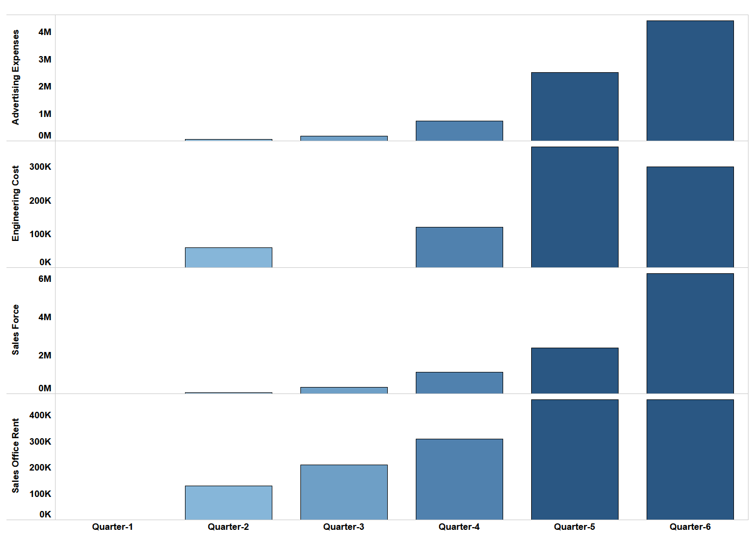
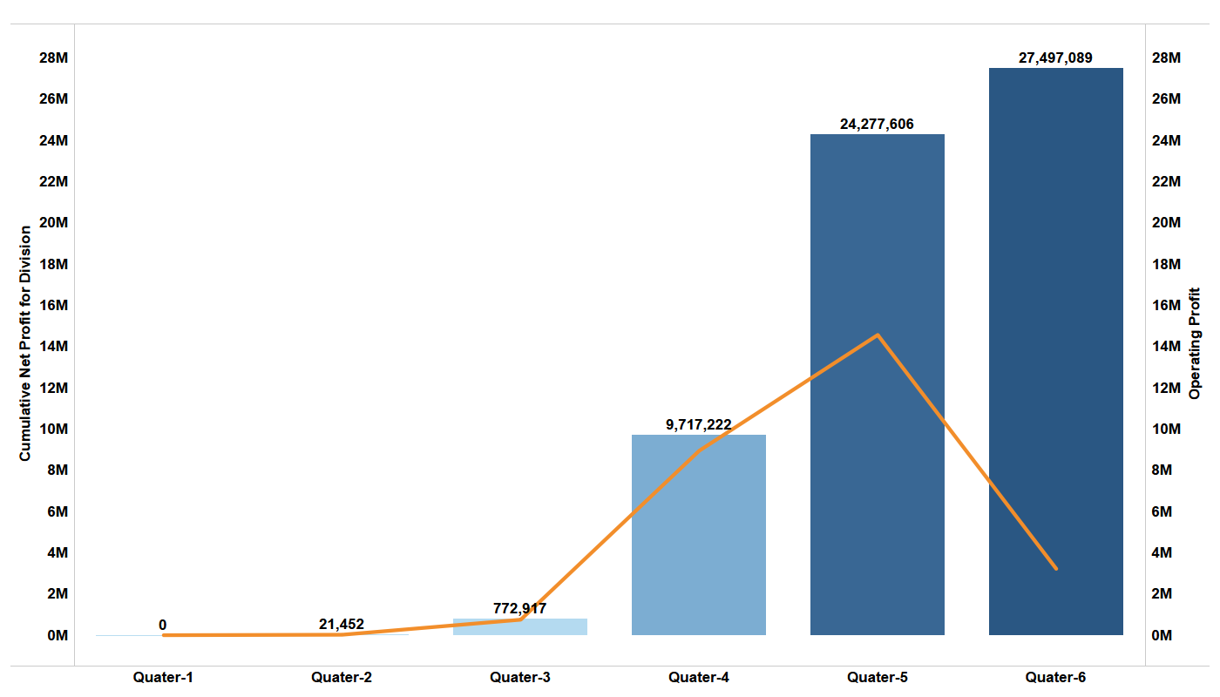
Financial Performance
Until quarter 5, the operating profit increased.
The major reasons we have identified for decrease in the profits in final quarter could be stated as below:
Low Brand Judgement. {Market seeks stability than dynamics}
Cannibalizing the existing products in the same market segment.
Timing of the market- Focus should have been shifted to more successful products

Slide 48

Financials Performance
Financial Performance
Financial Health of the Company
Growth Highlights, Cashflows and Profits

Slide 49
Financial Performance Growth Highlights
GROWTH
Certainly, there's a correlation between revenue & expenses
Reduction in growth of expenses explains reduction in revenues
Negative returns in Q6 could’ve been slightly due to reduction in growth of cash outflow
Growth Table
Quarter | Revenue | Operating Expenses | Operating Profit
Q3 | 332,66% | 138,15% | 3403,01%
Q4 | 632,66% | 212,54% | 1090,25%
Q5 | 152,14% | 151,76% | 62,79%
Q6 | -31,09% | 99,50% | -77,89%

Slide 50
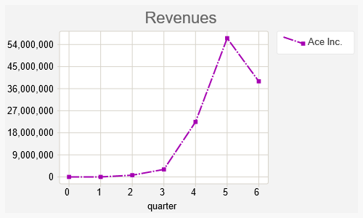
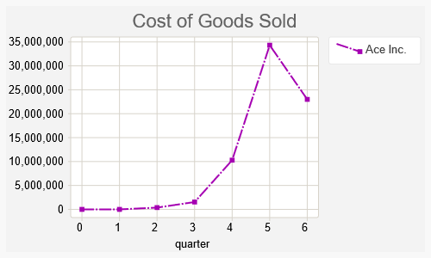
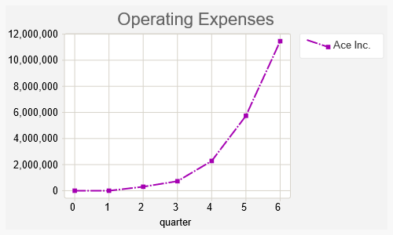
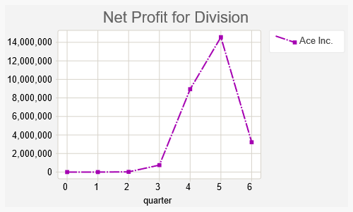
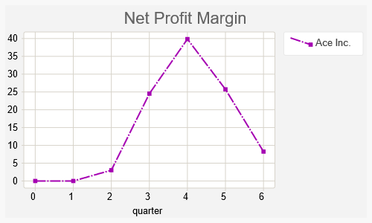
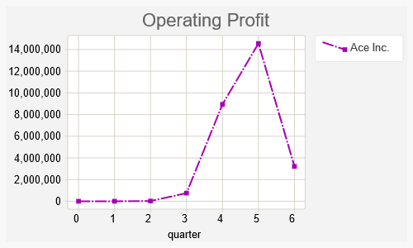
Financial Performance Cashflow & profit graphs
Growth of Operating expenses is exponential
Profit margin high until Q4, later couldn't sustain due to price war with competitors

Slide 51

Financial Performance
Highlights
Financial Health
Growth Highlights, Cash flows and Profits
How it could have been?

Slide 52
Financial Performance
How it could have been?
Although our initial risk averse approach helped us to amass comfortable amount of working capital and profits, as we want to be careful and be prepared for a worst case scenario as viewed during the lectures of going into bankruptcy and taking interest of as high as 25%, which would kill us instantly from the market, we could have done the following:
Targeted expenditure over salesforce, advertisements, brand management by allocating capital to expend for each section after a very thorough research & expansion strategies.
Reduction in growth of capital expenditure could have been curbed in the final quarters
We could have had healthy pricing competition in capable segments like Mercedes, Travellers and cutting down our focus on Workhorse segments where the price margins are barely enough to generate liquidity.
We could have designed all the brands we can in the initial quarters and focus on penetration and marketing those brands deep into the market heavily, instead of designing new brands each quarter which failed us to capture and channelize relationships with customers over established brands. Realization of best performing products is quite important in later market penetration. The faster we realize, the better it would be.

Slide 53

Performance Analysis of ACE Inc
Analysis of Performance, Brand Revenue, Share vs Expenses – Q5 and Q6

Slide 54
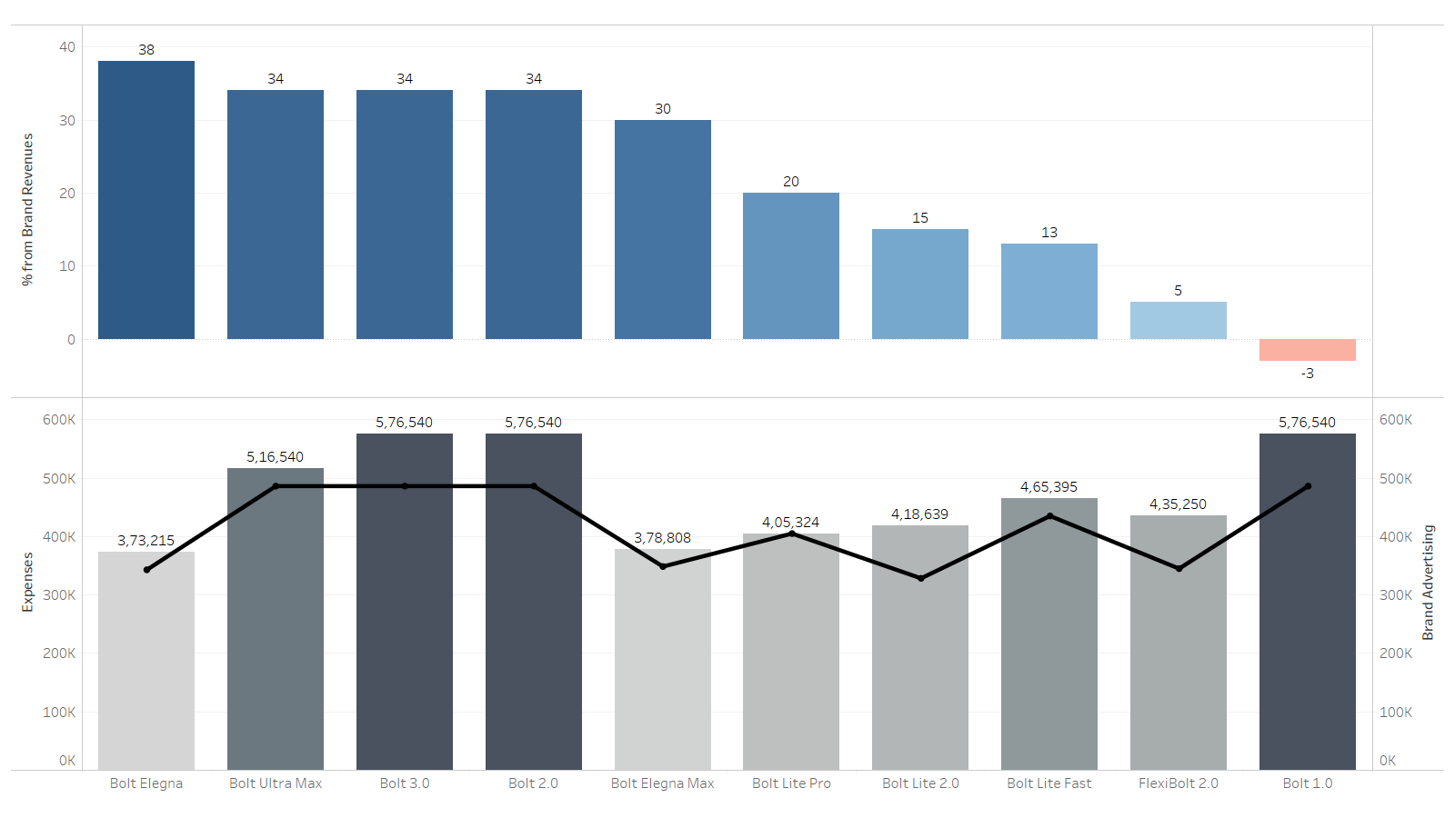
Analysis-Performance| Brand Revenue Share vs Expenses |Quarter 6
From the visualization we can infer that percentage of economic revenue from Bolt 1.0 suffered from unexpected down fall.
Funds invested in the brand does not guarantees the success of being profitable.

Slide 55
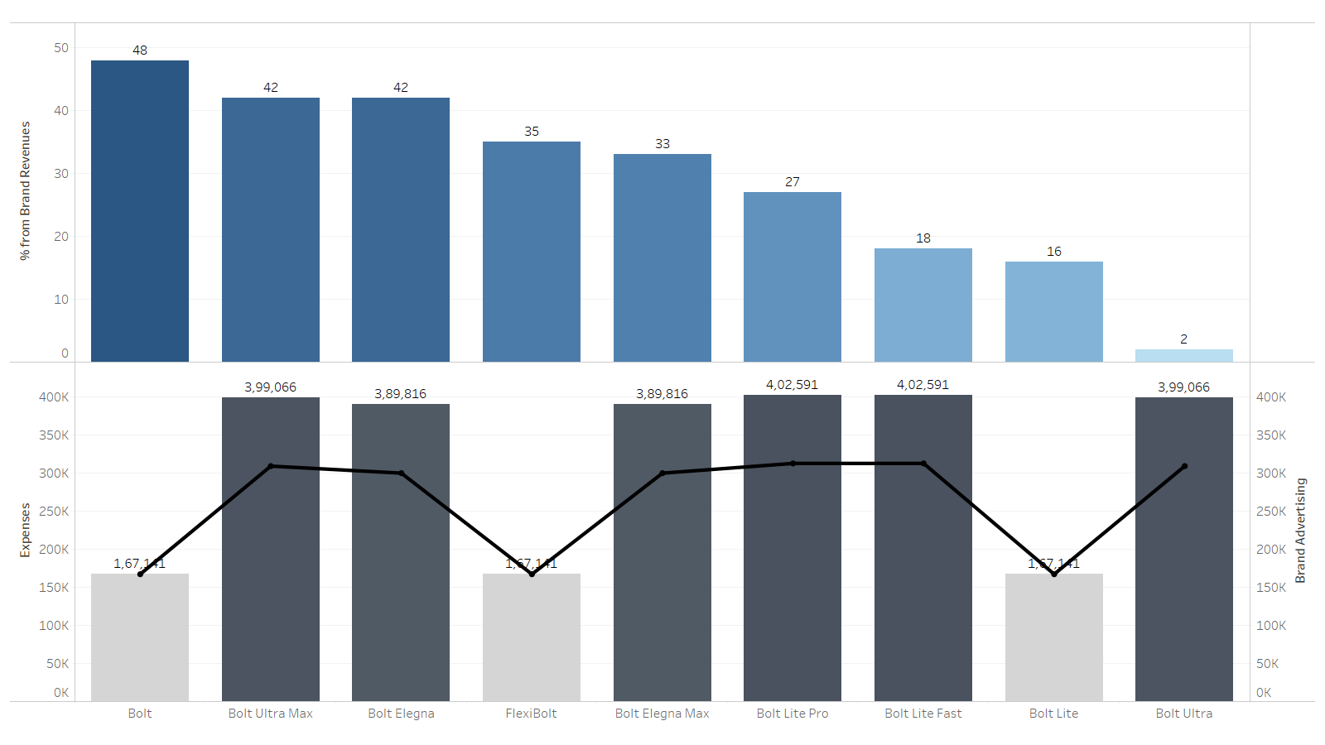
Analysis-Performance| Brand Revenue Share vs Expenses |Quarter 5
We introduced new advanced products namely, Bolt Ultra Max & Bolt Elegna which led considerable economic gain.
We assumed that we invested in right products at right time.
We can also observe that old products like Flexi Bolt and Bolt were also sufficiently profitable.

Slide 56
Performance Analysis of ACE Inc
Analysis of Performance,Brand Revenue,Share vs Expenses – Q5 and Q6
Analysis –Market Share

Slide 57
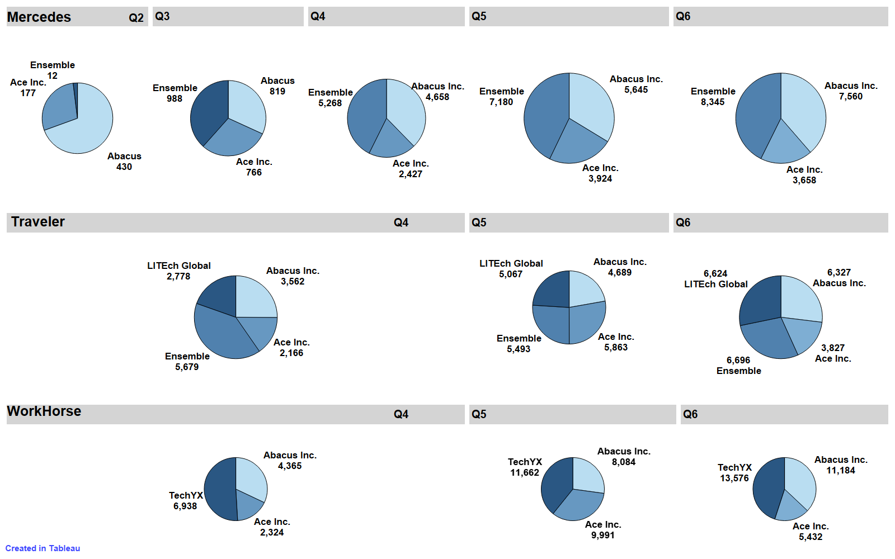
Analysis- Performance | Market share
This visualization tells us that our competitors and leaders have taken aggressive decisions from Q1. Whereas we were testing the market and have followed a defensive strategy.
After Q4 we changed our decision and took some aggressive decisions where we found that in Q5 our results were better than our competitors.

Slide 58
Performance Analysis of ACE Inc
Analysis of Performance,Brand Revenue,Share vs Expenses – Q5 and Q6
Analysis –Market Share
Analysis – Sales Force(ACE vs Competitors) of Q5 and Q6

Slide 59
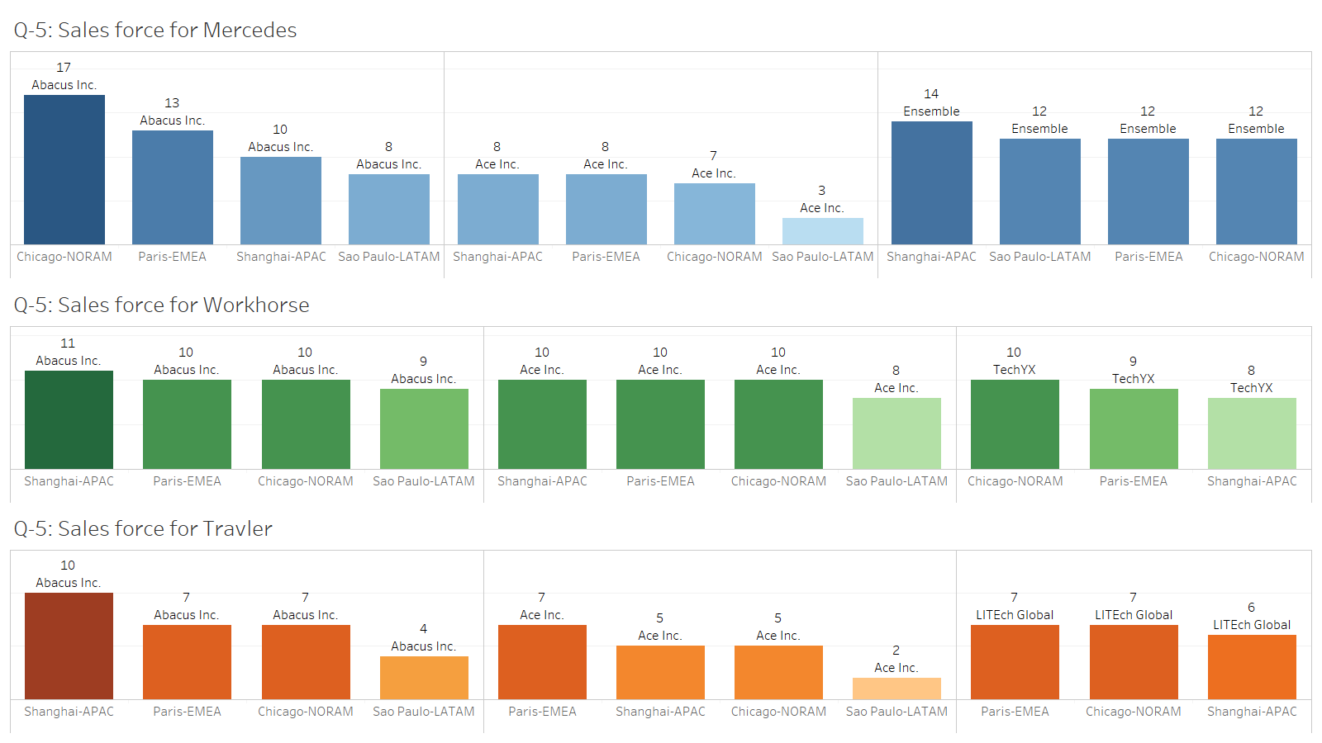
Analysis-Performance| Sales Force(ACE Inc. vs Competitor)|Quarter 5
Initially number of sales force was lower as compared to the competitors in all the three segments situated in all the locations.

Slide 60
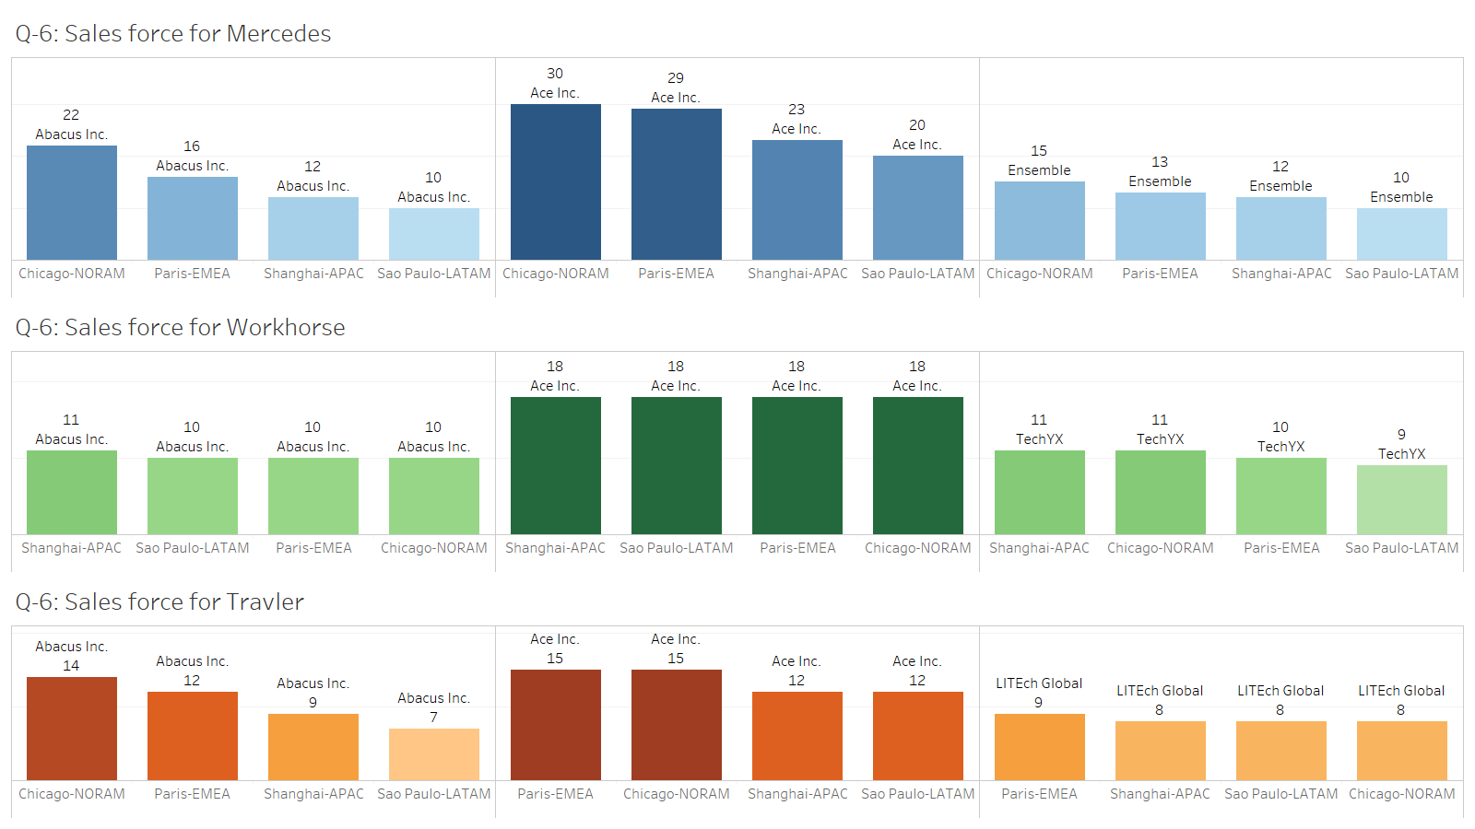
Analysis-Performance| Sales Force(ACE Inc. vs Competitor)|Quarter 6
As compared to the last quarter, we increased our sales force exponentially as compared to the competitors
in all the three segments situated globally.

Slide 61
Performance Analysis of ACE Inc
Analysis of Performance,Brand Revenue,Share vs Expenses – Q5 and Q6
Analysis –Market Share
Analysis – Sales Force(ACE vs Competitors) of Q5 and Q6
Points of Differentiation

Slide 62
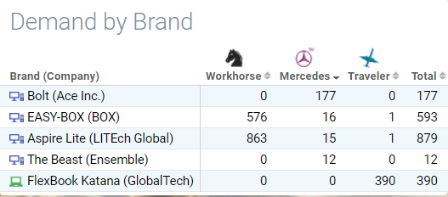
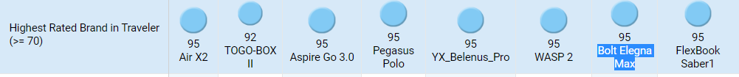
How do we differ?
Brands
In Q5 and Q6 we managed to grab the highest market share and also were the highest rated brand for our brand Elegna Max designed for traveller segment.
Advertisement
Blazing Fast-Our advertisement in Q3 for brand Bolt was the highest rated ad for Mercedes segment for Chicago region.
Traveller Paris-was the highest rated ad for the Paris region.(Rating=100)

Slide 63
Performance Analysis of ACE Inc
Analysis of Performance,Brand Revenue,Share vs Expenses – Q5 and Q6
Analysis –Market Share
Analysis – Sales Force(ACE vs Competitors) of Q5 and Q6
Points of Differentiation
SWOT

Slide 64
SWOT
Strengths
Weakness
Creative leadership &Teamwork
Adequate R&D investment
Price judgment is strong for all the target segments
Good brand management for target segments
Local Advertising
Failure to focus on primary target segment
Balance of Brand Judgement for other target segments.
Adaption to the price wars
Competitors new products and increased assortments
Delayed expansion of brand portfolio (Quarter -3)
Risk Averse - Initial Slow paced strategy for sales force allocation
S
W
T
O
Threats
Opportunity
High Operating Cost ( Low Financial Performance)
Reputation threat (highest rated brand in traveler)
Market awareness
Financial (Cash flow)
Existing Competition
Creation of diversified products
Investing more in media placement & sales people(Q2)
Deployment of Aggressive strategy

Slide 65
Performance Analysis of ACE Inc
Analysis of Performance,Brand Revenue,Share vs Expenses – Q5 and Q6
Analysis –Market Share
Analysis – Sales Force(ACE vs Competitors) of Q5 and Q6
Points of Differentiation
SWOT
Decisions

Slide 66


Lessons Learned| Decisions
Best Decisions
Worst Decisions
Differentiate amongst competitors
Take first movers advantage
Failed to adapt aggressive approach initially w.r.t products
Inadequate initial allocation of sales person.
Thorough market analysis enhances understanding of customer needs and wants
Develop good marketing mix - 4P’s
Pricing highly based on existing competition
Provide brand features that fulfill needs of market segments, otherwise customers finds products very complicated.

Slide 67
Performance Analysis of ACE Inc
Analysis of Performance,Brand Revenue,Share vs Expenses – Q5 and Q6
Analysis –Market Share
Analysis – Sales Force(ACE vs Competitors) of Q5 and Q6
Points of Differentiation
SWOT
Decisions
Personal Takeaways

Slide 68






Lessons Learned| Personal Takeaways
Dynamic nature of market, achieving economies of scale in-turn increase the profitability
Competitive position is gained based on customer’s willingness and overcoming competitor strategies
Introducing optimal number of brands within the same product range would decrease the possibility of cannibalizing the existing brand
In long term R&D investments boosts success and satisfies customer needs
Simulations allowed us to apply marketing concepts learnt in the course & allows to develop map for future success and adapt recommendations
Over exaggerating the advertisements could complicate the customers buying behavior
Simulation encourages critical thinking in evaluating current positions.

Slide 69
Performance Analysis of ACE Inc
Analysis of Performance,Brand Revenue,Share vs Expenses – Q5 and Q6
Analysis –Market Share
Analysis – Sales Force(ACE vs Competitors) of Q5 and Q6
Points of Differentiation
SWOT
Decisions
Personal Takeaways
ACE Reborn

Slide 70
ACE Reborn| Effective Perceived Strategy
Our focus in this move will be to invest marketing costs focusing on the successive product​
Releasing limited number of brands in new quarter. (For example, 2-3 brands in each quarter) to avoid self-cannibalisation
The new advertising strategy will focus more on the successful products and invest strategically in the old product for further development. ​
Advice to the new management team
Critically study the competitor strategies which will aid to gain competitive advantage.
Perform SWOT analysis at regular intervals for the overall development of the company.
Revise products according to the changing customer preferences and follow the changing technology trajectory to attract more customers.

Slide 71
Q&A
Thank you for your attention!

